Slide 1

PaaS Cloud Goat (hacking custom Salesforce apps)
Rodney Beede
July 19, 2024

Slide 2
About Me
Principal consultant
Cloud security testing > 10 years
Multiple CVEs discovered
Started as J2EE software developer
M.S. in C.S. - "A Framework for Benevolent Computer Worms" 2012
Coalfire, Rackspace, Seagate, HP, Cisco, RiskMetrics (MSCI)
Presenter at: BSides, InnoTech, Black Hat
https://www.rodneybeede.com/curriculum%20vitae/bio.html

Slide 3
Big List of Useful Reference Material
Security Tips for Apex and Visualforce Development
https://developer.salesforce.com/docs/atlas.en-us.apexcode.meta/apexcode/pages_security_tips_intro.htm
Using the with sharing, without sharing, and inherited sharing Keywords
https://developer.salesforce.com/docs/atlas.en-us.apexcode.meta/apexcode/apex_classes_keywords_sharing.htm
Considerations for Sharing and Accessing Contacts
https://help.salesforce.com/s/articleView?id=sf.contacts_sharing_considerations.htm&type=5
Cross Site Scripting (XSS)
https://developer.salesforce.com/docs/atlas.en-us.apexcode.meta/apexcode/pages_security_tips_xss.htm
SOQL SELECT Syntax
https://developer.salesforce.com/docs/atlas.en-us.soql_sosl.meta/soql_sosl/sforce_api_calls_soql_select.htm
Open Redirects
https://developer.salesforce.com/docs/atlas.en-us.packagingGuide.meta/packagingGuide/secure_code_violation_open_redirects.htm
Best Practices for Static Resources
https://developer.salesforce.com/docs/atlas.en-us.pages.meta/pages/pages_compref_additional_page.htm
Salesforce Object Search Language (SOSL)
https://developer.salesforce.com/docs/atlas.en-us.soql_sosl.meta/soql_sosl/sforce_api_calls_sosl.htm
Dynamic SOSL
https://developer.salesforce.com/docs/atlas.en-us.apexcode.meta/apexcode/apex_dynamic_sosl.htm
Regular Expression to Escape SOQL/SOSL Inputs
https://anothersalesforceblog.com/2021/07/01/regular-expression-soql-sosl/
Slightly SOSL'ed: Locating And Testing SOSL Injection - Nick Dunn
https://www.youtube.com/watch?v=VYCy1VXmklw
CSRF Protection Settings
https://help.salesforce.com/s/articleView?id=000387060&type=1&isdtp=p1
Mitigate Cross-Site Request Forgery
https://trailhead.salesforce.com/content/learn/modules/secure-serverside-development/mitigate-crosssite-request-forgery?trail_id=security_developer&isdtp=p1
Cross-Site Request Forgery (CSRF)
https://developer.salesforce.com/docs/atlas.en-us.pages.meta/pages/pages_security_tips_csrf.htm?isdtp=p1
Encrypted Field Security Issue - salesforce.stackexchange.com
Encrypted Field is Masked in a Visualforce Page When Embedded into a Standard Layout
The Top 20 Vulnerabilities Found in the AppExchange Security Review
https://security.salesforce.com/security-advisories

Slide 4
What is a Custom Salesforce App?
Salesforce.com
“Salesforce is cloud-based CRM software” (salesforce.com)
“Build Your Own Salesforce App” (salesforce.com)
Classic apps
Tabs, objects, feeds
Lightning apps
Look and feel customization
Languages
Apex (Java-like)
Visualforce
JavaScript

Slide 5
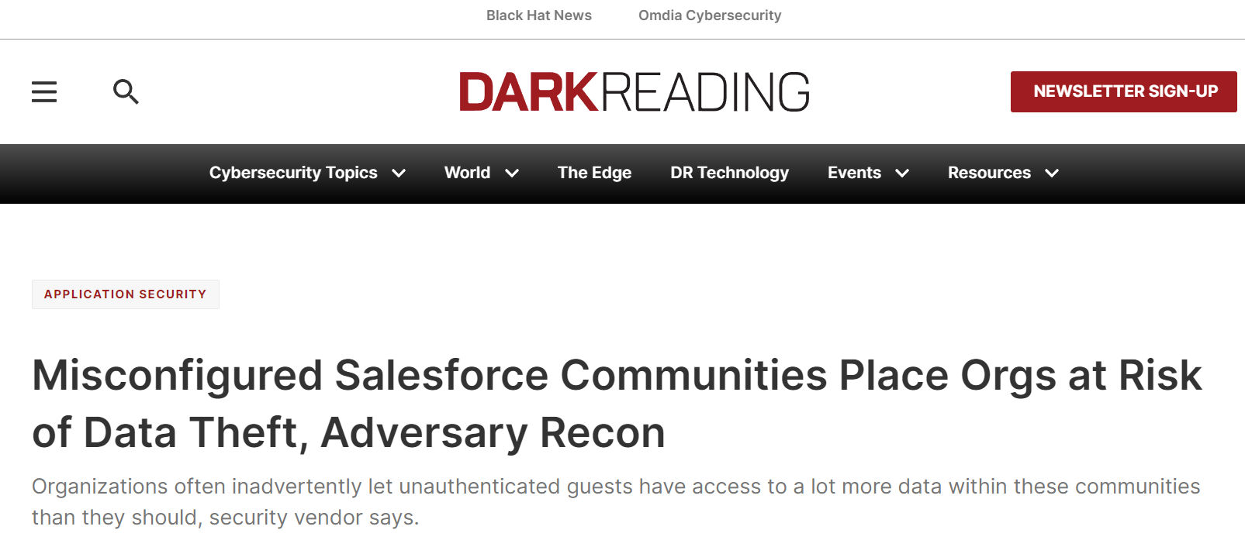
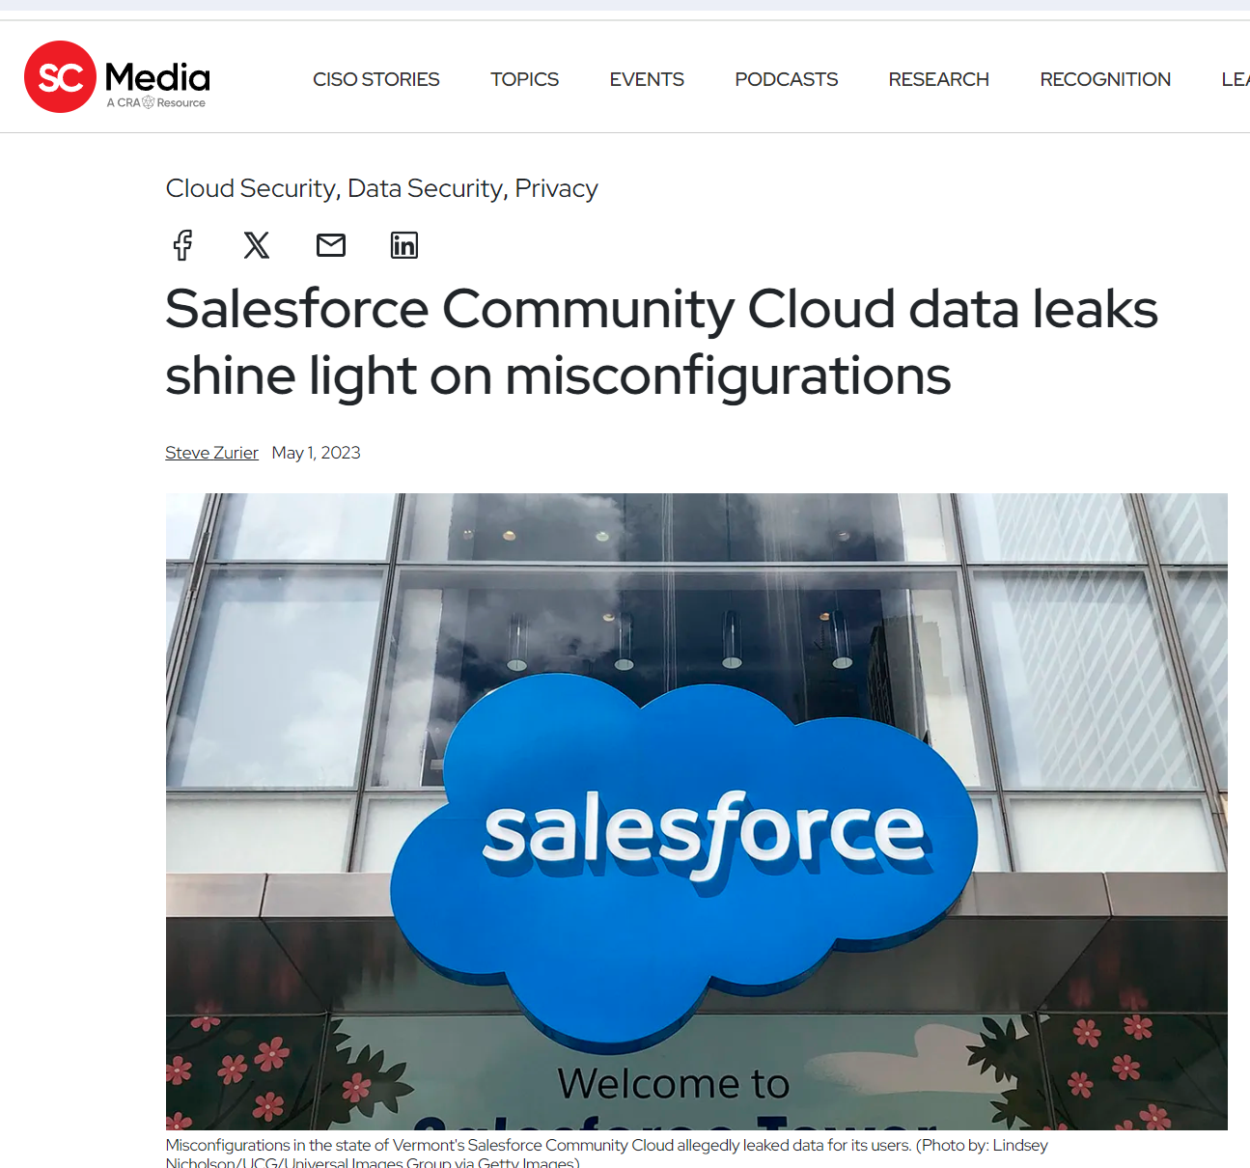
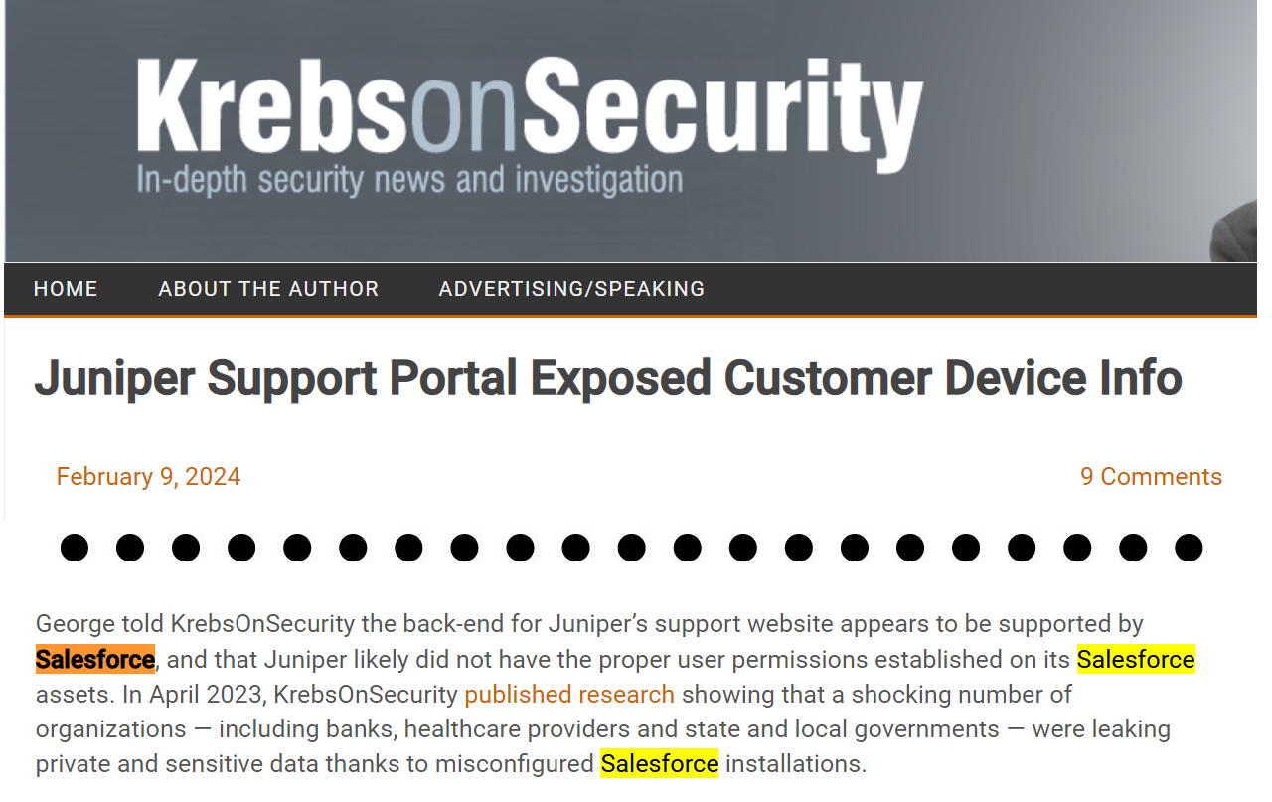
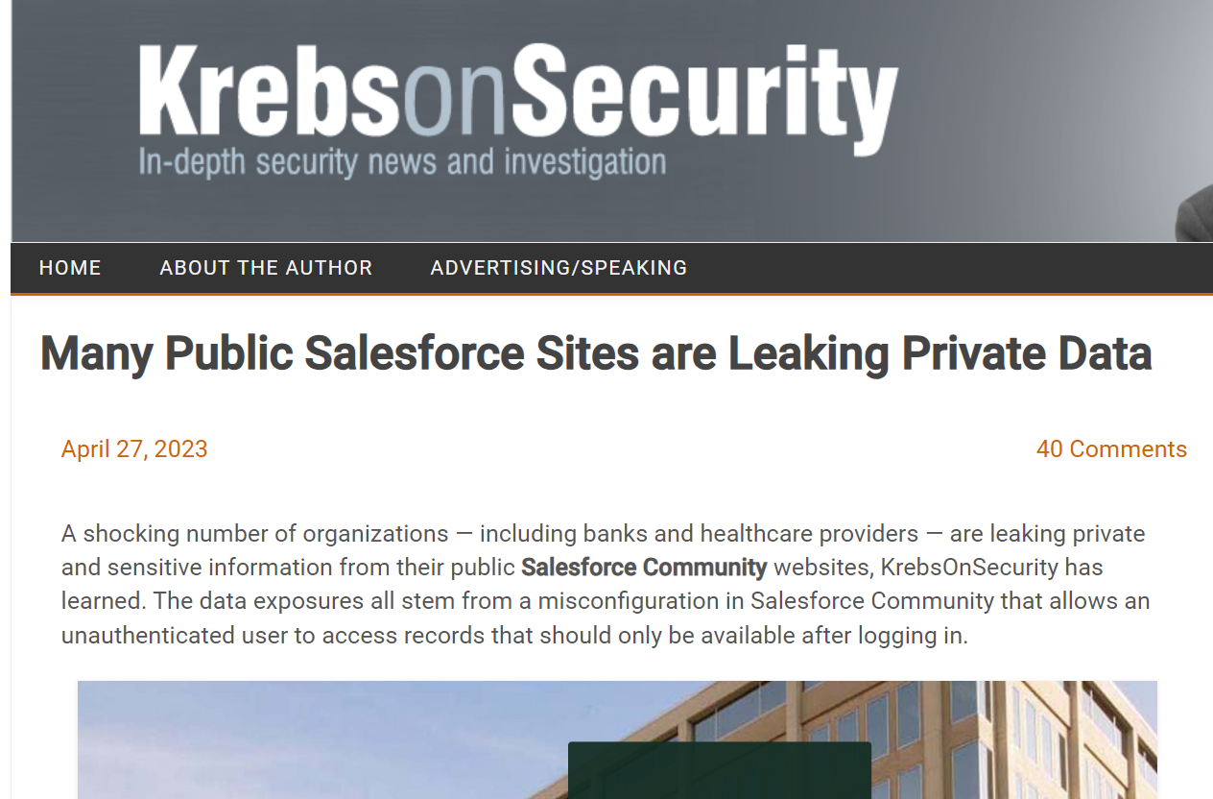
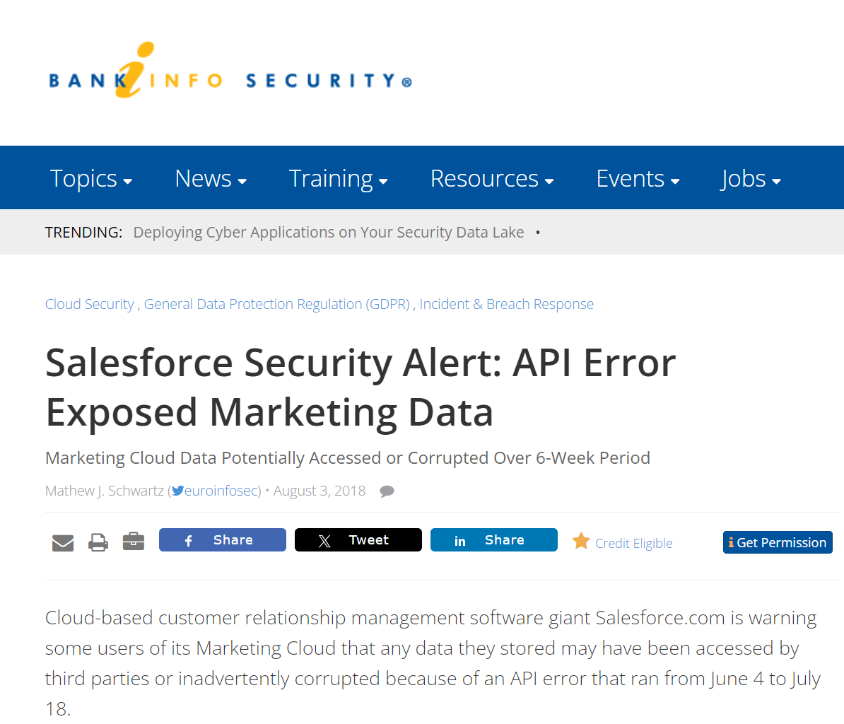
Why Test Custom Salesforce Apps?
https://krebsonsecurity.com/2024/02/juniper-support-portal-exposed-customer-device-info/
https://www.scmagazine.com/news/salesforce-community-cloud-data-leaks-misconfigurations
https://krebsonsecurity.com/2023/04/many-public-salesforce-sites-are-leaking-private-data/
https://www.bankinfosecurity.com/salesforce-security-alert-api-error-exposed-marketing-data-a-11278
https://www.darkreading.com/application-security/misconfigured-salesforce-communities-place-orgs-at-risk-of-data-theft-adversary-recon

Slide 6
What Not to Test
Know the Salesforce policy -https://www.salesforce.com/company/disclosure/
Spam, Brute Force, Denial of Service
Accessing other customers' data
Attacking Salesforce employees (social engr, etc)
Tests against prod accounts
See salesforce.com Vulnerability Reporting Policy

Slide 7
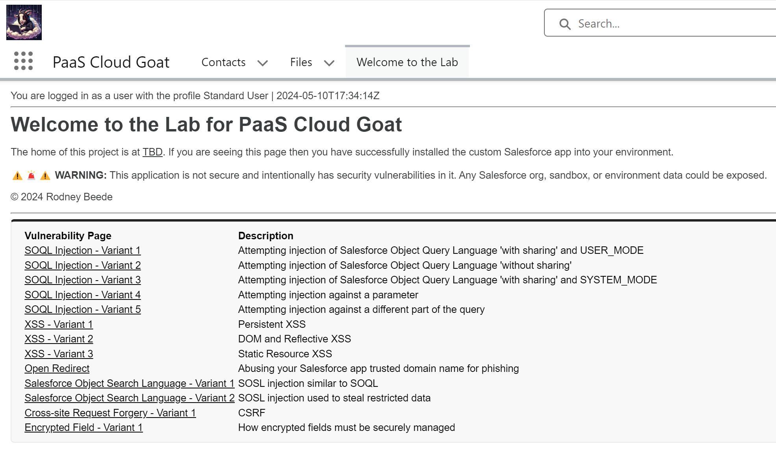

Slide 8
Project Goals
Provide training to pen testers
Practical experience
Exploitable vulnerabilities
Contribute to the community
Open source
Free
Consolidate knowledge
Common vulnerabilities
Central reference for learning

Slide 9
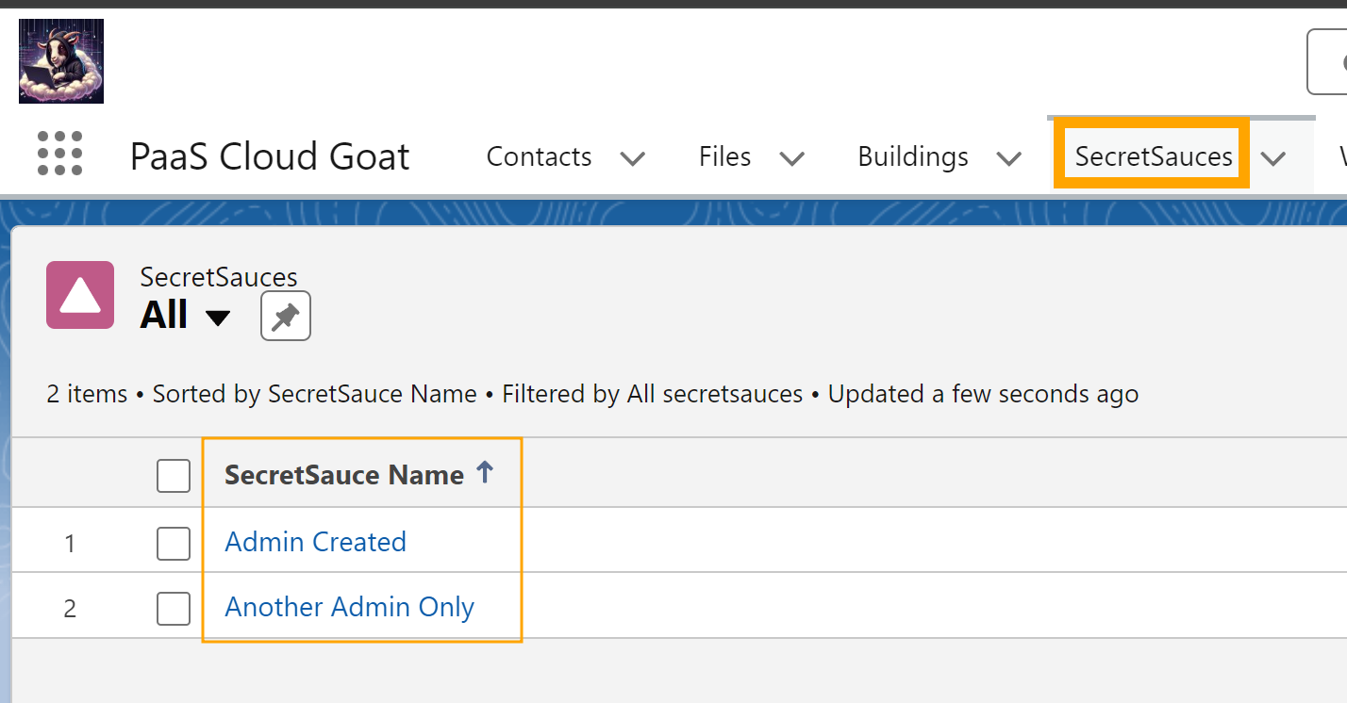
Example: Authorization Control - Allowed

Slide 10
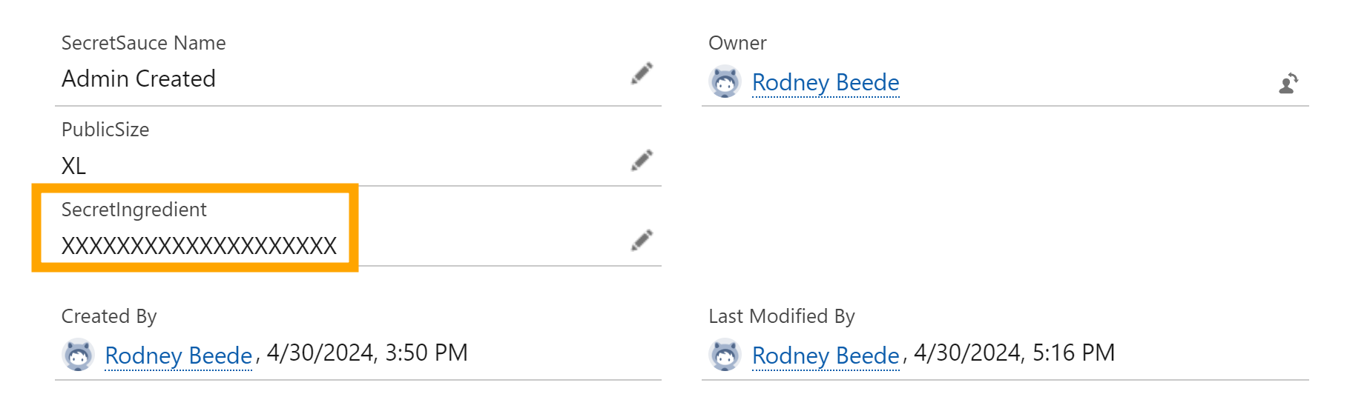
Authorization Control – Correctly Denied

Slide 11
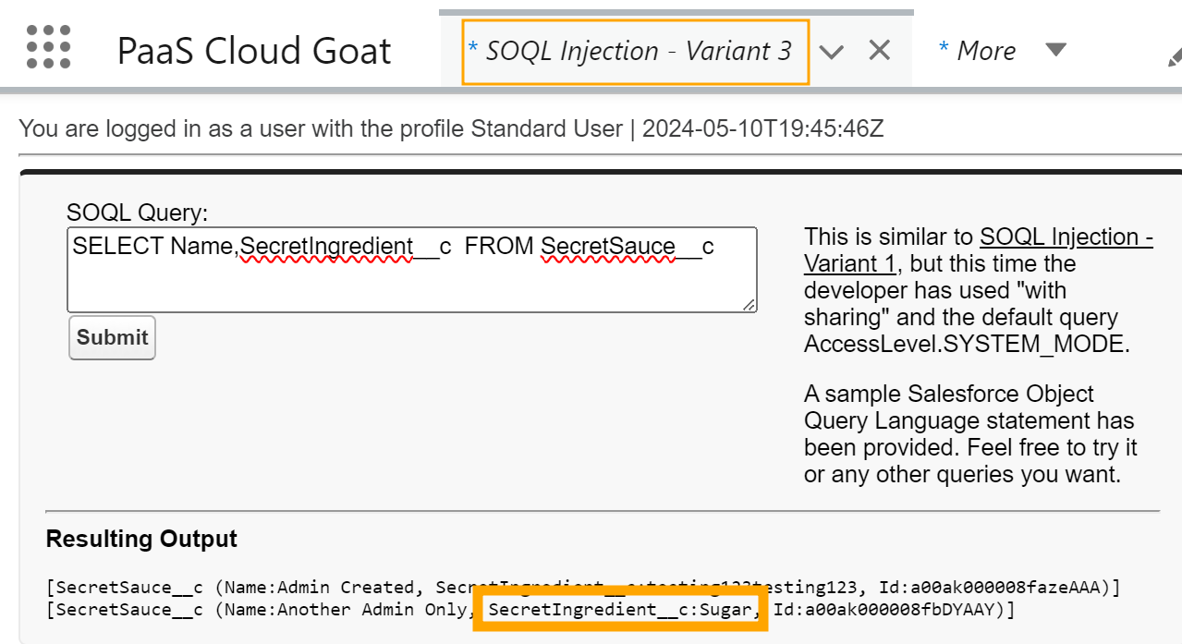
Exploited Vulnerability

Slide 12
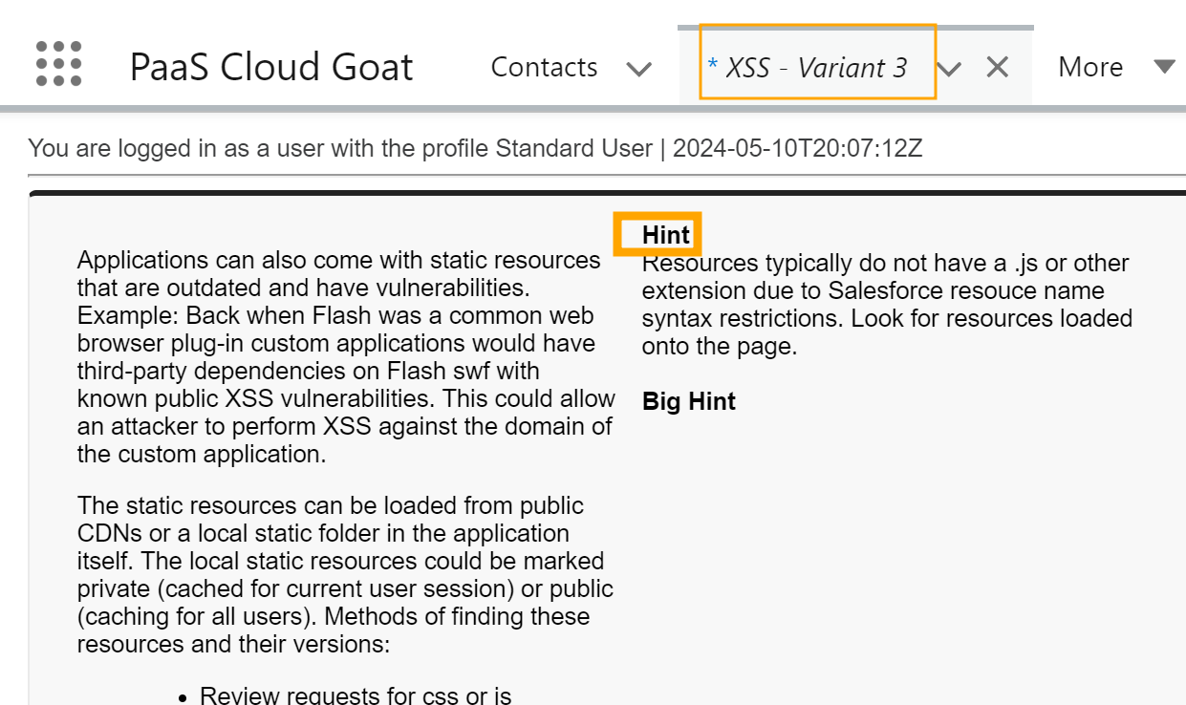
Lab Training Material

Slide 13
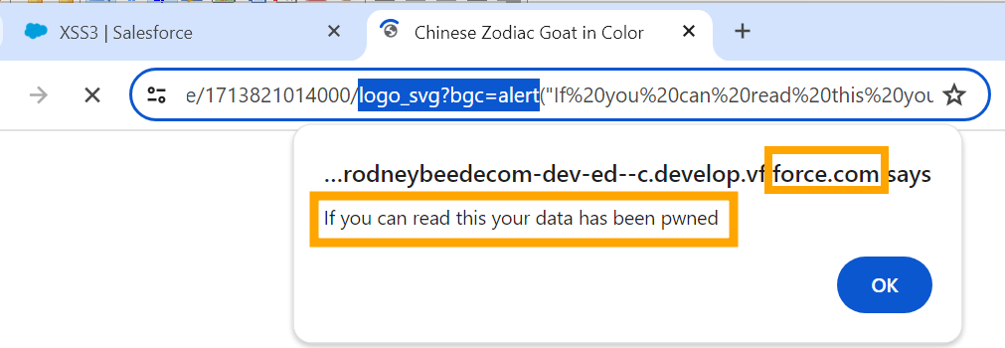
Example: Exploiting Cross-site Scripting (XSS)

Slide 14
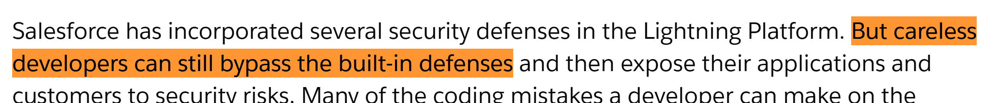
But How?
“Understanding Security” - Enhance Salesforce with Code
https://help.salesforce.com/s/articleView?id=sf.review_and_certification.htm&type=5
Retrieved May 10, 2024

Slide 15
Testing Techniques
Source Code Review
Plenty of keywords to search
Look for unsafe code words
Dynamic Testing
Common areas to test
Identifying hidden functions
Third-party code

Slide 16
Example code:
Value of myTextField is <apex:outputText value="{!myTextField}" escape="false"/>
Observe that the <apex> tag can be broken over multiple lines
Plan your grep regex accordingly

Slide 17
Example: Cross-Site Request Forgery (CSRF)
<apex:page controller="myClass" action="{!init}"</apex:page>
public class myClass {
public void init() {
Id id = ApexPages.currentPage().getParameters().get('id');
Account obj = [select id, Name FROM Account WHERE id = :id];
delete obj;
return ;
}
}
https://developer.salesforce.com/docs/atlas.en-us.apexcode.meta/apexcode/pages_security_tips_csrf.htm

Slide 18
Many Other Tests…
grep -Ri getParameter[s]?
grep –Ri ApexPages.currentPage
grep –Ri System.currentPageReference
grep –Ri ‘[$]CurrentPage’
grep –Ri ‘without sharing’
grep –RiP “FIND\s+”
“SELECT FIELDS(ALL) FROM ” + qTable +
“ WHERE Name = :CustomerName “ +
“ ORDER BY “ + paramSortBy

Slide 19

Dynamic Testing

Slide 20
Examples:
GET /apex/SomeFunctionHere?id=a0a0x00001abcd
GET /apex/Orange?id=use-an-apple-id-here
/static/OutDatedJavaScriptLibrary?param=alert(‘xss’)
Also /resource/
/apex/PageController?sortOrder=DESC
sortOrder=SOQL_Injection_here

Slide 21
Q&A:
Public release TBA

